Slide 1

Theorising mixed methods research
Dr Andi Fugard (they/them)
a.fugard@bbk.ac.uk

Slide 2
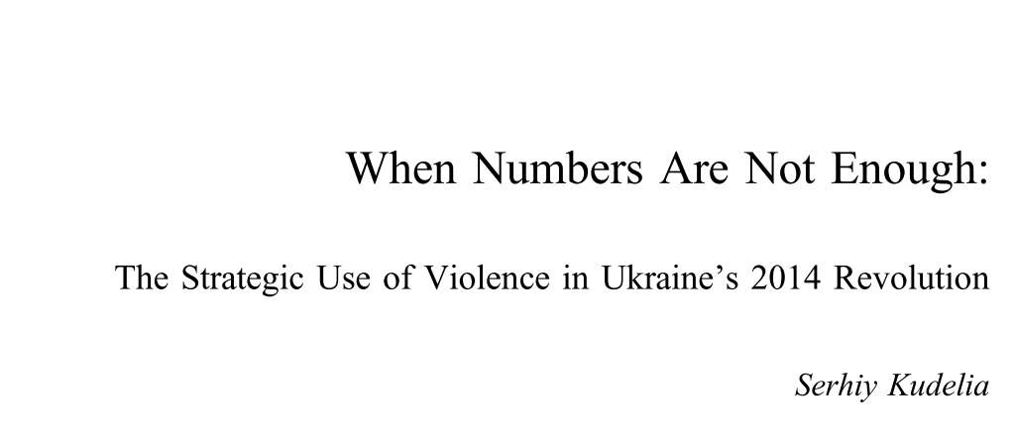
Kudelia, S. (2018) ‘When Numbers Are Not Enough: The Strategic Use of Violence in Ukraine’s 2014 Revolution’, Comparative Politics, 50, pp. 501–521. doi: 10.5129/001041518823565623.

Slide 3
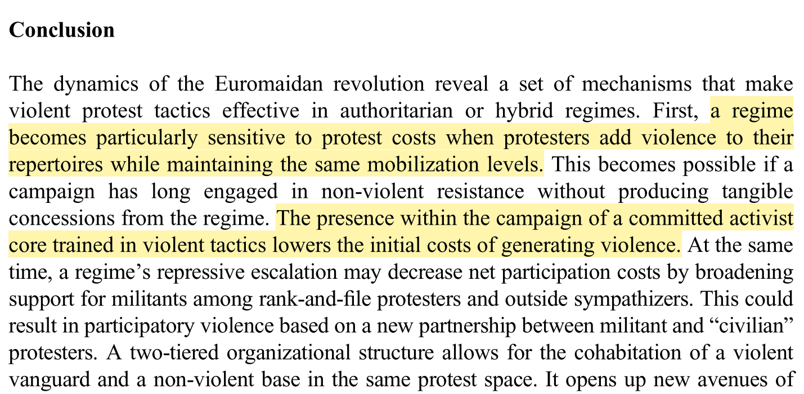

Slide 4
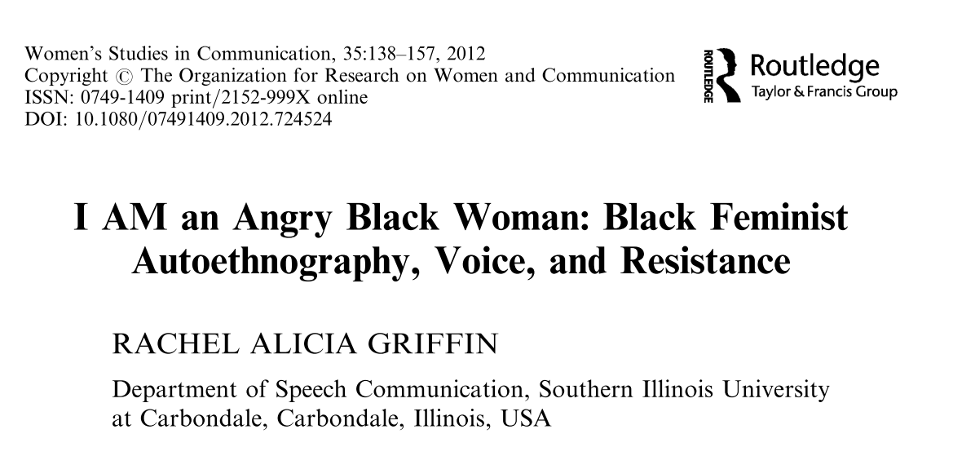
Griffin, R. A. (2012) ‘I AM an Angry Black Woman: Black Feminist Autoethnography, Voice, and Resistance’, Women’s Studies in Communication, 35, pp. 138–157. doi: 10.1080/07491409.2012.724524.

Slide 5
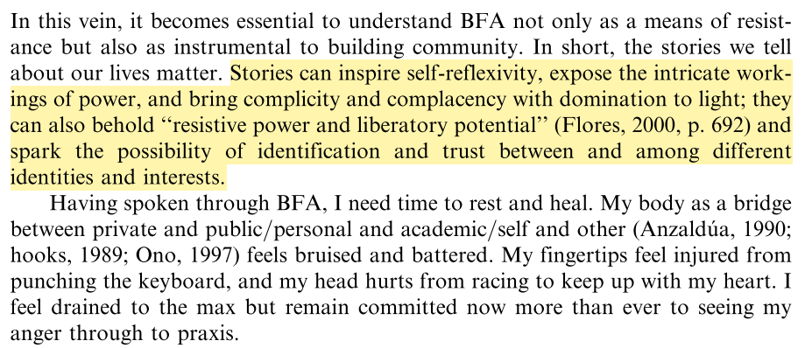

Slide 6
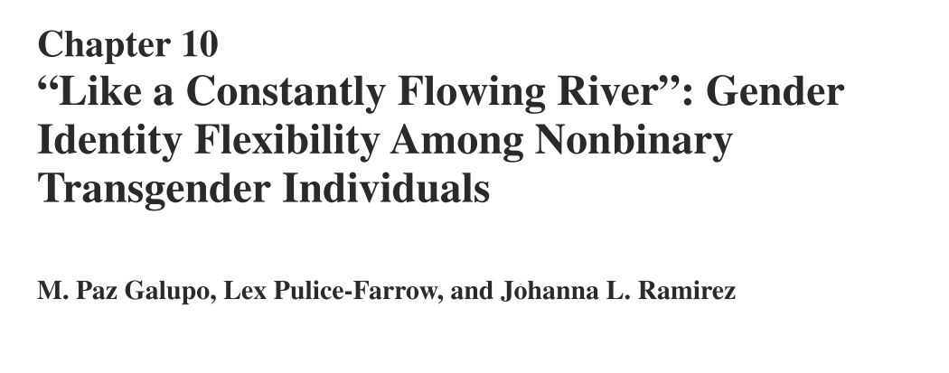

Slide 7
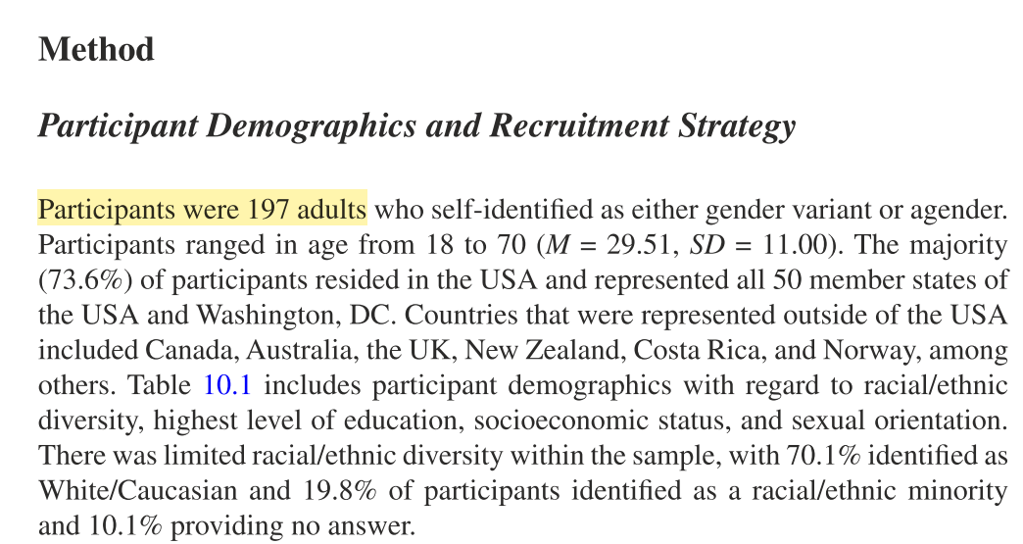

Slide 8
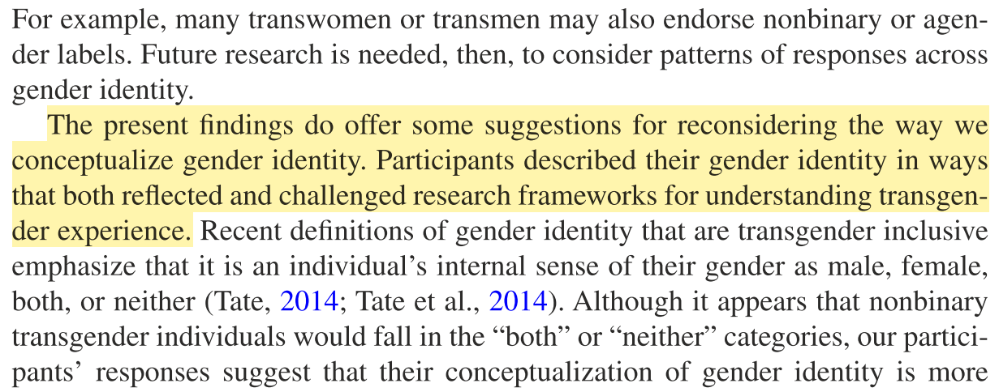
Galupo, M. P., Pulice-Farrow, L. and Ramirez, J. L. (2017) ‘“Like a Constantly Flowing River”: Gender Identity Flexibility Among Nonbinary Transgender Individuals’, in Identity Flexibility During Adulthood. Cham: Springer International Publishing, pp. 163–177. doi: 10.1007/978-3-319-55658-1_10.

Slide 9
The plan!
The mixed methods paradigm shift
What’s different about theorising using qual versus quant analysis?
Causation in theories drawing on mixed methods

Slide 10
The new approach of mixed methods
‘… modern research must reject as a false dichotomy the separation between “qualitative” and “quantitative” studies, or between “statistical” and the “nonstatistical” approach. The application of mathematics to sociology does not ensure rigor of proof, any more than the use of “insight” guarantees the significance of the research.’
Goode, W. J., & Hatt, P. K. (1952).
[Cited by Pelto 2015]

Slide 11
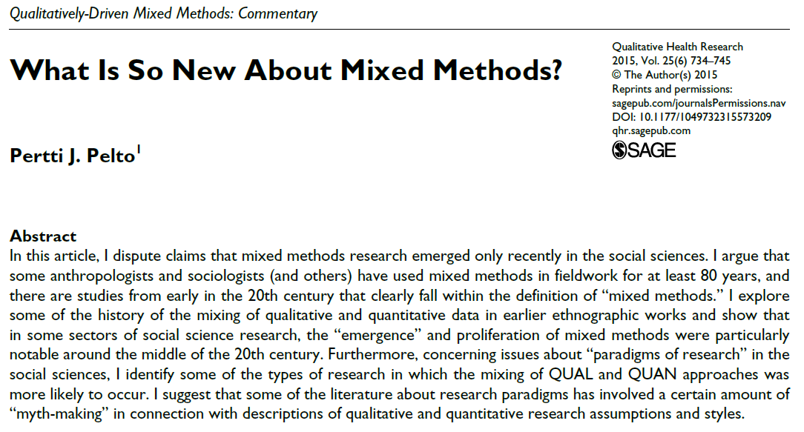

Slide 12
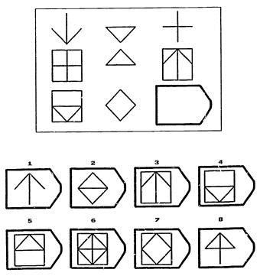

Slide 13
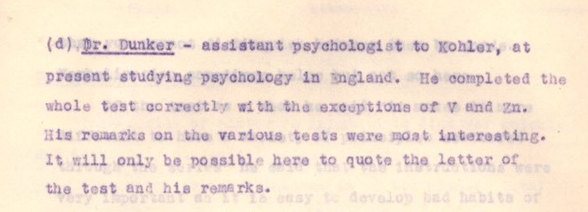
Raven’s (1936, pp. 118-9) MSc thesis, developing his IQ test

Slide 14
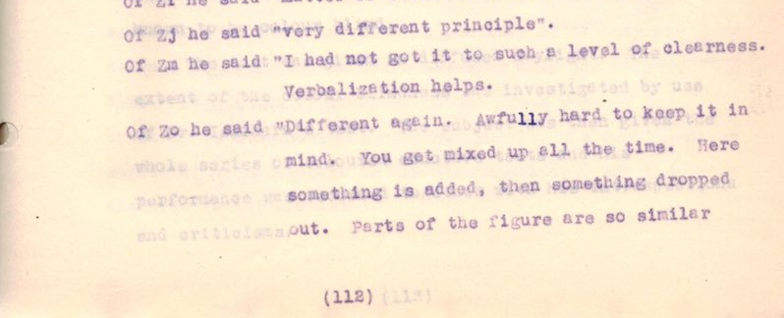
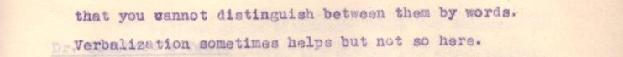
Raven’s (1936, pp. 118-9) MSc thesis, developing his IQ test

Slide 15
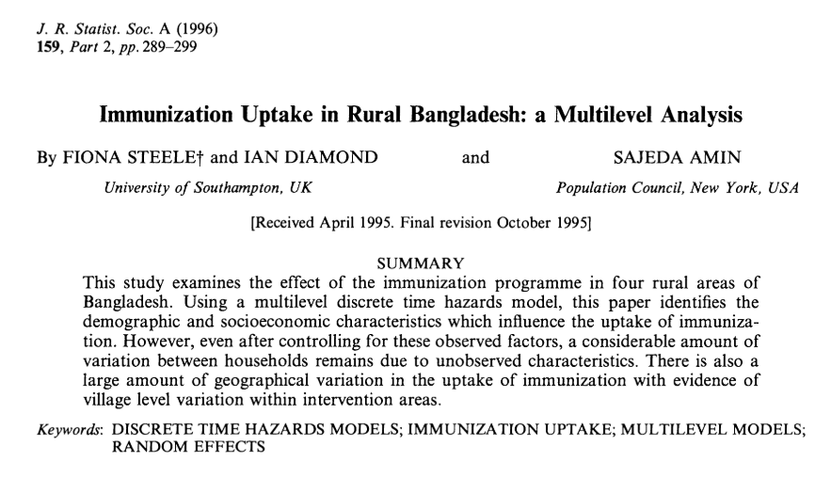

Slide 16
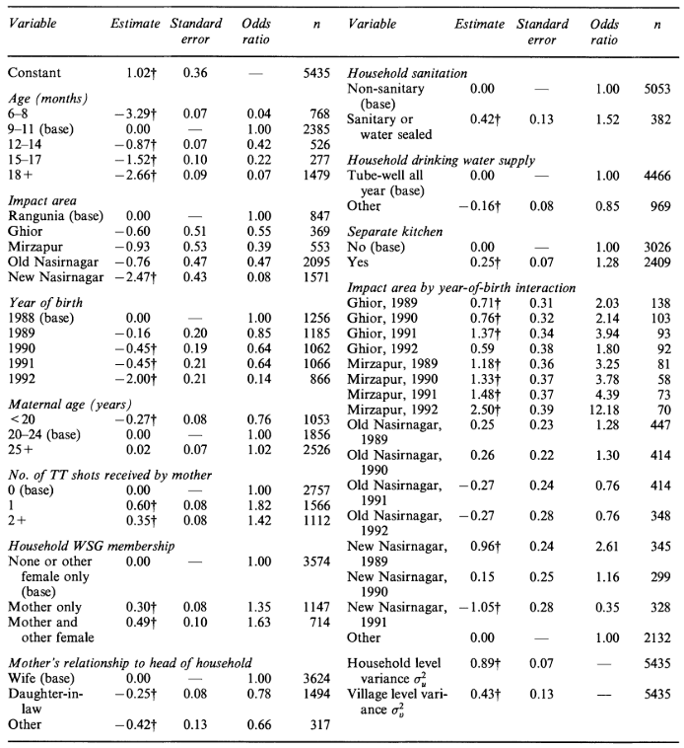
Lots of quants

Slide 17
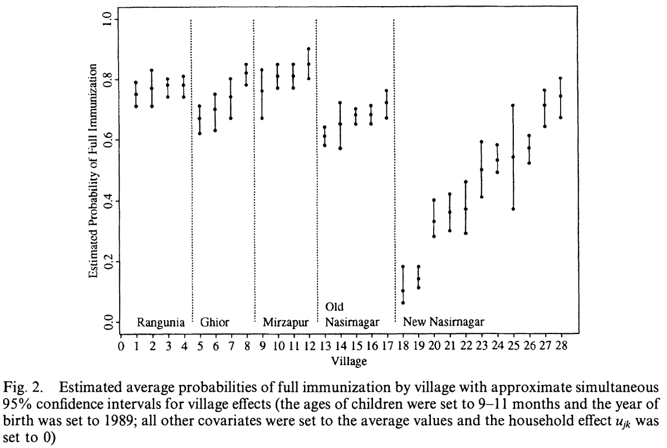

Slide 18
“… one particular Bangladeshi village would have been expected to have high levels of immunization, whereas it was down in the middle of the table with quite a large confidence interval. This seemed rather strange, but our colleagues were able to attribute this to a fundamentalist imam. […] Another example is a village at the top of the league table, which our colleagues could attribute to a very enthusiastic school-teacher.”
Ian Diamond and Fiona Steele, comment on Goldstein and Spiegelhalter, 1996, p. 429, League tables and their limitations: statistical issues in comparisons of institutional performance. Journal of the Royal Statistical Society. Series A (Statistics in Society) 159, 385–443.

Slide 19
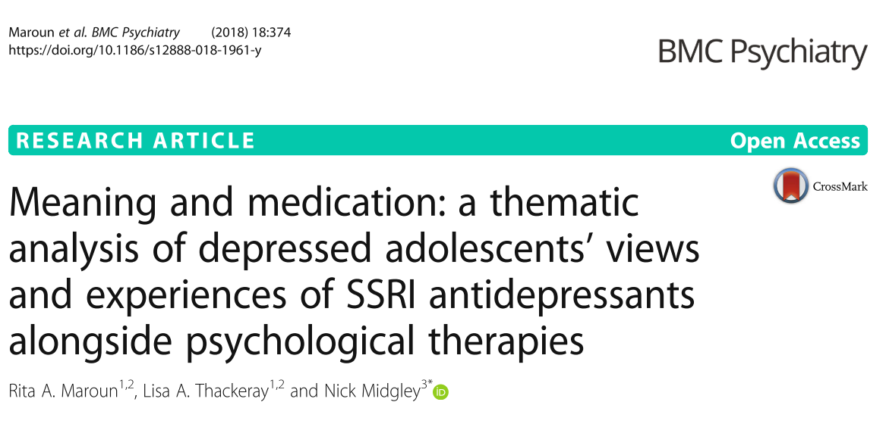
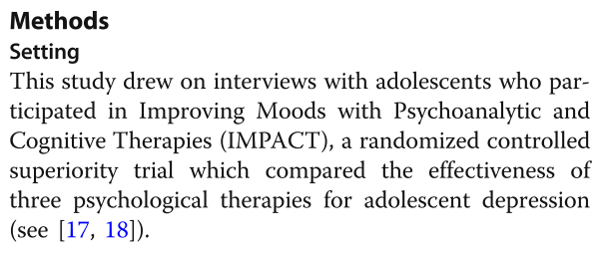

Slide 20
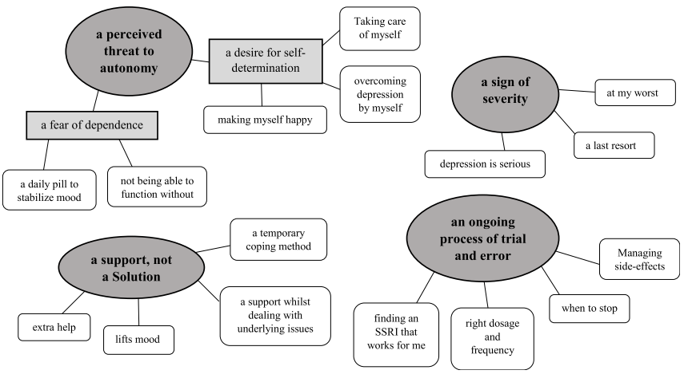

Slide 21
Pelto (2015, p. 744)
‘I am not saying here that the various writings about the “two paradigms” and the concepts of “mixed methods” have been a total waste of time. […] However, I have a feeling that for people who are involved in real, applied research projects, dealing with real-world issues, much of the language about the abstract characteristics of the qualitative and quantitative paradigms is not particularly useful.’

Slide 22
Okay, mixing is groovy and everyone does it, so what’s the problem?
Quant researchers worry about causation
Qual researchers avoid(?) causation
Theories… tend to talk about causation!
What happens when qual and quant are mixed?
Does qual research really have nothing to say about causation?

Slide 23
Qual researchers are said to be often social constructionist (Hathcoat & Meixner, 2017)
“Social constructionists tend to adhere to ontological realism while embracing a relativistic epistemology (Crotty, 1998). Thus it makes little sense for a constructionist to develop a new causal theory. [??!]
“Also, constructionists are interested in discourse; hence, it may be more likely for a constructionist to pose questions about how culture shapes our views of causation or how the language of interventionist designs has perpetuated social inadequacies.”

Slide 24
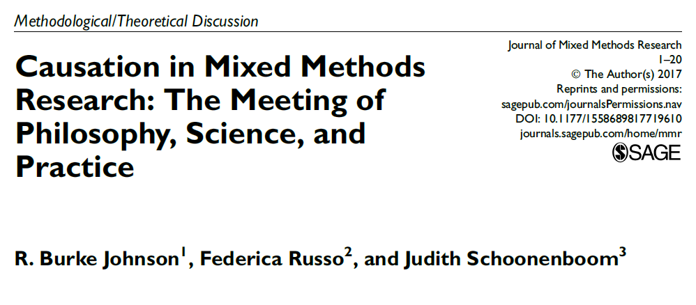
Warm up examples from

Slide 25
Example 1(a)
“… deciding to attend university is mainly influenced by school performance, which is boosted by parent expectations (pushed up by SES); they also have a direct effect on the university decision. Peer support has a small effect as well.”

Slide 26
Example 1(b)
“Nynke van der Molen, whose mother trained as a social worker but is bitter about the fact that she never worked outside the home, and whose father wants Nynke to work in the family florist shop. […] Nynke’s closest friend, Leonie, decided in the first semester of 1989-1990 to go to university, before Nynke started work in a stable. That occurred about when her mother showed her a scrapbook from social work school—a moving eye-opener for Nynke—and preceded Nynke’s decision in the second term to enroll in veterinary studies.”

Slide 27
Example 2(a)
“Providing textbooks to schools where they are scarce can substantially increase the average student test scores. However, in an RCT in rural Kenya, in which primary schools were randomized to treatment condition, this effect was not found.”

Slide 28
Example 2(b)
“… the majority of the children were unable to read these difficult textbooks, written in English, which was not their first language.
“Further quantitative subgroup analysis showed that there was an effect for high-achieving students, who were able to read their textbooks.”

Slide 29
Example 3(a)
“… youth at risk were exposed to a short spell of prison life, on the basis of the theory that this experience would be enough to keep them on a straight path. That is, prison life leads to being scared, which leads to improved behavior once in the real world.”

Slide 30
Example 3(b)
“Qualitative data, however, showed no relationship between the program and improved behavior. A different mechanism was operating: rather than being scared, some youth enjoyed prison life, saw prisoners as role models, and prisoners they met provided them with criminal contacts outside”

Slide 31
A solution?

Slide 32
Singular vs. general causation
Singular causation
“That particular iceberg caused the Titanic to sink”
“Joe Bloggs voted Brexit because he believed it would lead to £350 million/week going to the NHS rather than food shortages”
General causation
“Smoking causes lung cancer”
“Proximity leads to decreased prejudice and discrimination”

Slide 33
Determinism vs. indeterminism
Strong determinism:
Every event is “fully caused” – “there is only one possible instantiation of the world”
Moderate indeterminism:
“perhaps more in line with mixed methods thinking… there is some regularity and some ‘free play’ or probability”
Strong indeterminism:
“the world is mostly nonregular and complex and not at all predictable”

Slide 34
Individualism vs. holism (we have been here before)
Individualism
Describe social phenomena in terms of individual people’s actions
Holism
Describe at level of social concepts, which “emerge” from lower-level concepts

Slide 35
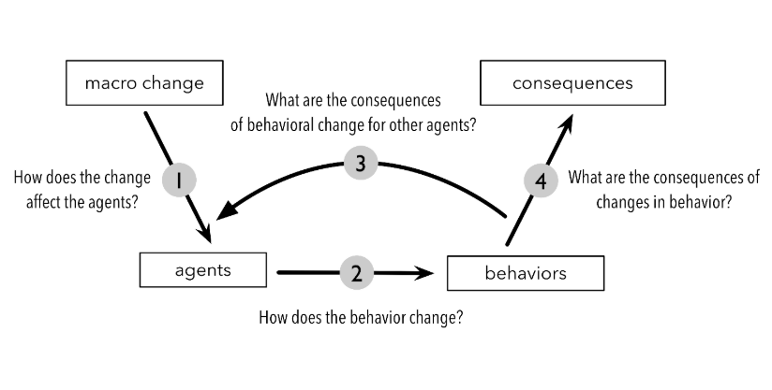
Ylikoski P., Mechanism-based theorizing and generalization from case studies, Studies in History and Philosophy of Science (2018), doi: https://doi.org/10.1016/j.shpsa.2018.11.009

Slide 36
Molar vs. molecular causation
Molar causation
“Whole package”, e.g., social-economic status is used to explain an effect
Molecular causation
“Specific components” required, e.g., “unpack SES into its component parts, determining their separate possible/relative influences (i.e., social status, education, and income).”

Slide 37
Causal description vs. explanation
Description
X causes Y
Explanation
X causes Y through mechanism M
“Qualitative research can help in understanding causal explanation through observations, interviews, and case studies”

Slide 38
Account | When/how does C cause E?
Probabilistic | C alters the chances of occurrence of E.
Counterfactual | If C had occurred, E would have occurred, and if C had not occurred E would not have occurred either.
Regularism | Occurrences of E regularly follow occurrences of C.
Necessary and sufficient | Causes are insufficient, but a nonredundant part of an unnecessary but sufficient condition.
Manipulation and invariance | Manipulating C makes E occur and the relation between C and E is stable enough
Mechanistic | There is a mechanism linking C to E.
Agency | Consideration and decision (C) to act by an agent causes agency controlled behavior (E).

Slide 39

Causal mosaics
“Causal concepts are like tiles that, put next to one another, and in the right way, will let an image emerge. And the image will be a sophisticated causal theory. So, the question is how to arrange the tiles, in order to create a recognizable and useful image for each research study.”
Jossie Ayame

Slide 40
Bradford Hill criteria (as summarised by Burke Johnson et al.)
1. Strength of association. The stronger the relationship between the independent variable and the dependent variable, the less likely it is that the relationship is due to an extraneous variable.
2. Temporality. It is logically necessary for a cause to precede an effect in time.
3. Consistency. Multiple observations, of an association, with different people under different circumstances and with different measurement instruments increase the credibility of a finding.

Slide 41
4. Theoretical plausibility. It is easier to accept an association as causal when there is a rational and theoretical basis for such a conclusion.
5. Coherence. A cause-and-effect interpretation for an association is clearest when it does not conflict with what is known about the variables under study and when there are no plausible competing theories or rival hypotheses. In other words, the association must be coherent with other knowledge.
6. Specificity in the causes. In the ideal situation, the effect has only one cause. In other words, showing that an outcome is best predicted by one primary factor adds credibility to a causal claim.

Slide 42
7. Dose–response relationship. There should be a direct relationship between the risk factor (i.e., the independent variable) and people’s status on the disease variable (i.e., the dependent variable).
8. Experimental evidence. Any related research that is based on experiments will make a causal inference more plausible.
9. Analogy. Sometimes, a commonly accepted phenomenon in one area can be applied to another area.

Slide 43
Sample of the non-exhaustive list of “truthmakers”
(a) Evidence of capacities (i.e., Does the causal variable have the capacity or ‘‘causal oomph’’ to produce the effect?)
…
(f) Evidence of information causation (i.e., Is there a link or some sort of ‘‘causal line’’ or movement/ transmission of bits of ‘‘information’’ from C to E?)

Slide 44
(h) Causal evidence at multiple levels (e.g., social, psychological, biological, and physical levels of reality)
…
(j) Evidence of reasonableness (i.e., Does a causal relation between C and E make sense?)

Slide 45

Summary
Researchers have been mixing methods in individual studies for years – even in the purist of quant research
Theorists have too, when they draw on varied sources
Argument here is that a rich tapestry of understandings of causation are needed to make sense of mixed qual/quant evidence when theorising
a.fugard@bbk.ac.uk

